Slide 1
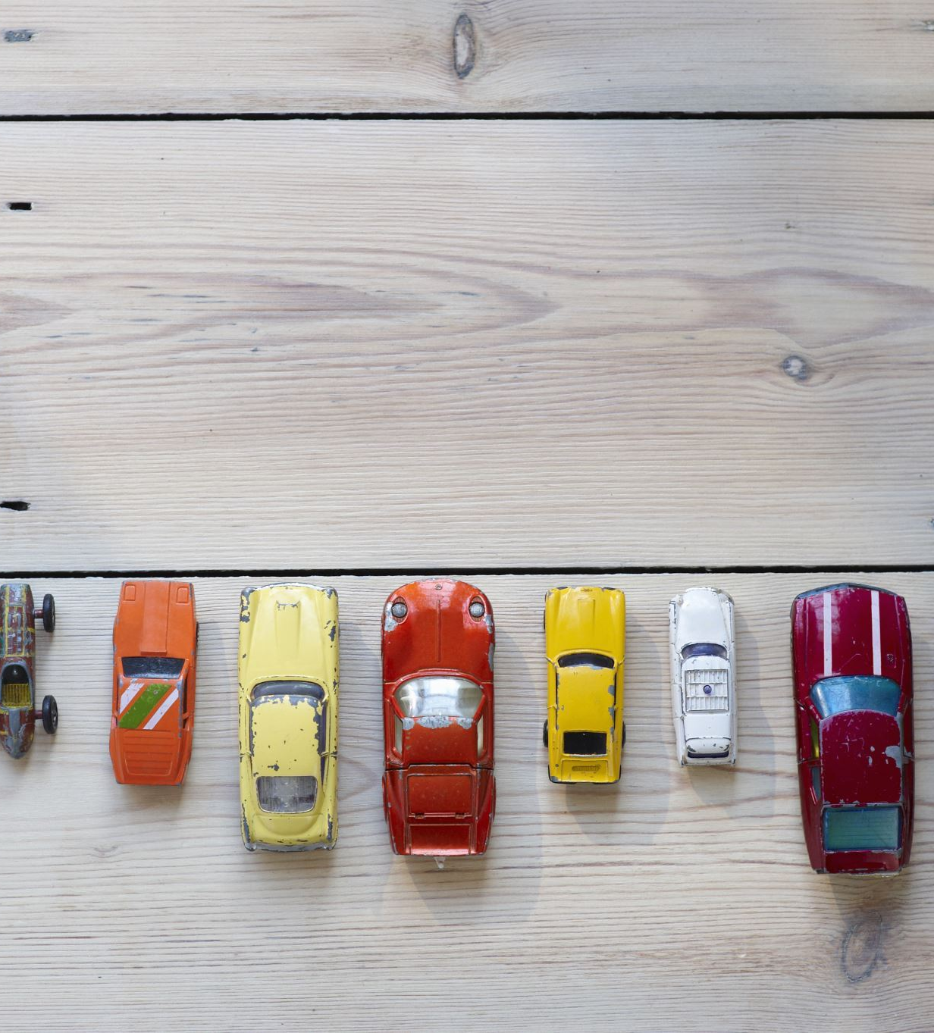
Car Price Prediction
Enterprise Architectures for Big Data
Poonam D/o Gavri Shanker, 1938896
Muhammed Ikbal Sevinc, 1936115

Slide 2
Purpose of the Project
Purpose of the project is to create a streamlit web app that predicts the selling price of cars for users who want to sell and buy cars

Slide 3
Tools
Python
Linear Regression
Streamlit

Slide 4
Structure
1.Preparing the Data
2.Creating ML Models
3.Visualizing with Streamlit

